Slide 1
If You Want To Learn How To Use This Template Watch The Full Tutorials On My Youtube Channel
👇
https://www.youtube.com/watch?v=SRGGZiCxB0o
Learn How To Design Overlapped Text Effect
👇
https://www.youtube.com/watch?v=-hmbycbiVNc
Font:
https://fonts.google.com/specimen/Montserrat

Slide 2

D
C
B
A
Type Your Intro Here

Slide 3
D
C
B
A
Type Your Intro Here

Slide 4
D
C
B
A
Type Your Intro Here

Slide 5
D
C
B
A
Type Your Intro Here

Slide 6
D
C
B
A
Type Your Intro Here

Slide 7
D
C
B
A
Type Your Intro Here

Slide 8
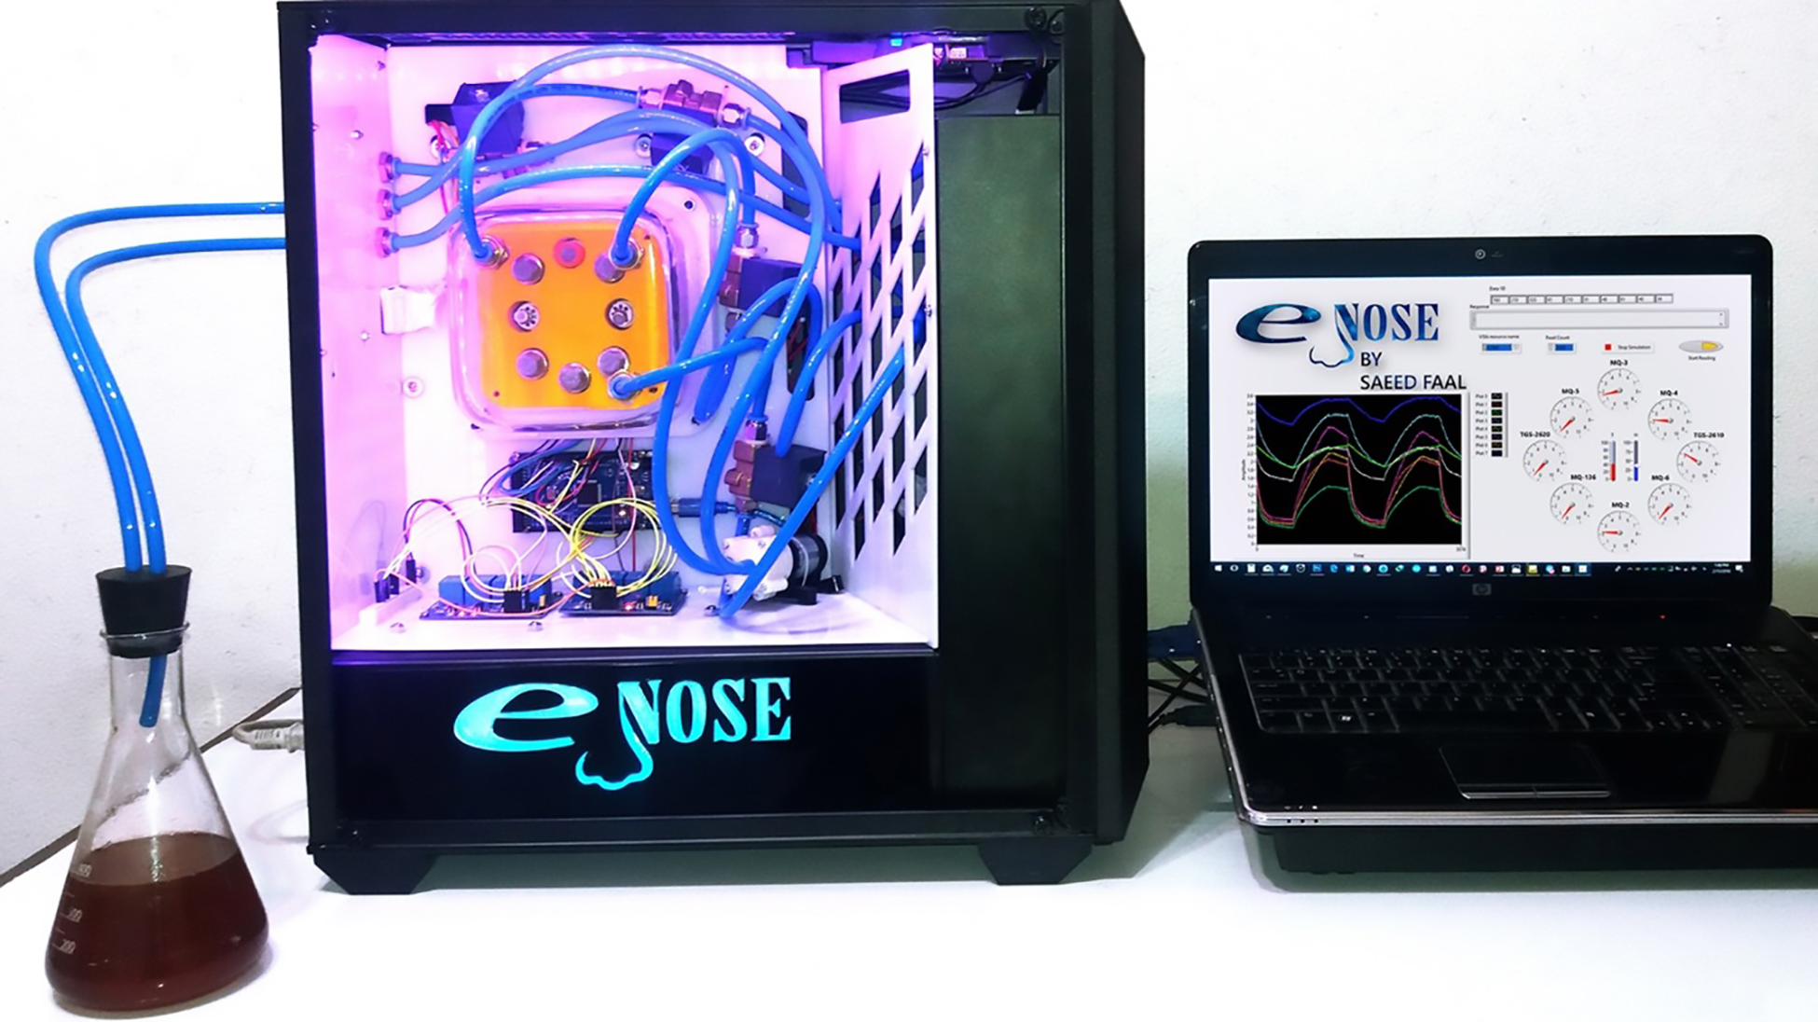
Selected Sensors
D
Different Sensors Types
C
TGS 2610
TGS 2620
MQ 3
TGS 813
MQ 2
MQ 4
Sensor
Detect
Detection range (PPM)
MOSFET
B
Methane, Butane, LPG, smoke
MQ 6
MQ 5
MQ-2
200-5000
CP
A
TGS 822
TGS 832
MQ 137
MQ-3
Alcohol, Ethanol, smoke
0.05-10
Tested Sensors
Choosing Gas Sensors
MQ-4
Methane, CNG Gas
200-10000
MQ-5
Natural gas, LPG
200-10000
MQ 7
MQ 8
MQ 135
TGS 815
TGS 880
TGS 2600
MQ 138
MOS
QCM
MQ-6
LPG, butane gas
200-10000
MQ 9
MQ 136
MQ-136
Hydrogen Sulfide gas
1-200
TGS-2610
High sensitivity to LP
500-10000
TGS-2620
For alcohol, toluene, xylene
500-5000

Slide 9
Selected Sensors
D
Different Sensors Types
C
TGS 2610
TGS 2620
MQ 3
TGS 813
MQ 2
MQ 4
Sensor
Detect
Detection range (PPM)
MOSFET
B
Methane, Butane, LPG, smoke
MQ 6
MQ 5
MQ-2
200-5000
CP
A
TGS 822
TGS 832
MQ 137
MQ-3
Alcohol, Ethanol, smoke
0.05-10
Tested Sensors
Choosing Gas Sensors
MQ-4
Methane, CNG Gas
200-10000
MQ-5
Natural gas, LPG
200-10000
MQ 7
MQ 8
MQ 135
TGS 815
TGS 880
TGS 2600
MQ 138
MOS
QCM
MQ-6
LPG, butane gas
200-10000
MQ 9
MQ 136
MQ-136
Hydrogen Sulfide gas
1-200
TGS-2610
High sensitivity to LP
500-10000
TGS-2620
For alcohol, toluene, xylene
500-5000

Slide 10
Selected Sensors
D
Different Sensors Types
C
Sensor
Detect
Detection range (PPM)
TGS 2610
TGS 2620
MQ 3
TGS 813
MQ 2
MQ 4
MOSFET
B
Methane, Butane, LPG, smoke
200-5000
MQ 6
MQ 5
MQ-2
CP
A
MQ-3
Alcohol, Ethanol, smoke
0.05-10
TGS 822
TGS 832
MQ 137
Choosing Gas Sensors
Tested Sensors
MQ-4
Methane, CNG Gas
200-10000
MQ-5
Natural gas, LPG
200-10000
MQ 7
MQ 8
MQ 135
TGS 815
TGS 880
TGS 2600
MQ 138
MOS
QCM
MQ-6
LPG, butane gas
200-10000
MQ 9
MQ 136
MQ-136
Hydrogen Sulfide gas
1-200
TGS-2610
High sensitivity to LP
500-10000
TGS-2620
For alcohol, toluene, xylene
500-5000

Slide 11
D
Selected Sensors
Different Sensors Types
C
TGS 2610
TGS 2620
MQ 3
TGS 813
MQ 2
MQ 4
Sensor
Detect
Detection range (PPM)
MOSFET
B
Methane, Butane, LPG, smoke
MQ 6
MQ 5
MQ-2
200-5000
CP
A
TGS 822
TGS 832
MQ 137
MQ-3
Alcohol, Ethanol, smoke
0.05-10
Choosing Gas Sensors
Tested Sensors
MQ-4
Methane, CNG Gas
200-10000
MQ-5
Natural gas, LPG
200-10000
MQ 7
MQ 8
MQ 135
TGS 815
TGS 880
TGS 2600
MQ 138
MOS
QCM
MQ-6
LPG, butane gas
200-10000
MQ 9
MQ 136
MQ-136
Hydrogen Sulfide gas
1-200
TGS-2610
High sensitivity to LP
500-10000
TGS-2620
For alcohol, toluene, xylene
500-5000

Slide 12
Selected Sensors
D
Different Sensors Types
C
TGS 2610
TGS 2620
MQ 3
TGS 813
MQ 2
MQ 4
Sensor
Detect
Detection range (PPM)
MOSFET
B
Methane, Butane, LPG, smoke
MQ 6
MQ 5
MQ-2
200-5000
CP
A
TGS 822
TGS 832
MQ 137
MQ-3
Alcohol, Ethanol, smoke
0.05-10
Choosing Gas Sensors
Tested Sensors
MQ-4
Methane, CNG Gas
200-10000
MQ-5
Natural gas, LPG
200-10000
MQ 7
MQ 8
MQ 135
TGS 815
TGS 880
TGS 2600
MQ 138
MOS
QCM
MQ-6
LPG, butane gas
200-10000
MQ 9
MQ 136
MQ-136
Hydrogen Sulfide gas
1-200
TGS-2610
High sensitivity to LP
500-10000
TGS-2620
For alcohol, toluene, xylene
500-5000

Slide 13

Selected Sensors
D
Different Sensors Types
C
TGS 2610
TGS 2620
MQ 3
TGS 813
MQ 2
MQ 4
Sensor
Detect
Detection range (PPM)
MOSFET
B
Methane, Butane, LPG, smoke
MQ 6
MQ 5
MQ-2
200-5000
CP
A
TGS 822
TGS 832
MQ 137
MQ-3
Alcohol, Ethanol, smoke
0.05-10
Choosing Gas Sensors
Tested Sensors
MQ-4
Methane, CNG Gas
200-10000
Thank You
MQ-5
Natural gas, LPG
200-10000
MQ 7
MQ 8
MQ 135
TGS 815
TGS 880
TGS 2600
MQ 138
MOS
QCM
MQ-6
LPG, butane gas
200-10000
MQ 9
MQ 136
MQ-136
Hydrogen Sulfide gas
1-200
TGS-2610
High sensitivity to LP
500-10000
TGS-2620
For alcohol, toluene, xylene
500-5000

